Slide 1
The aim of this project is to perform a comparative analysis of serial and parallel implementation of Otsu thresholding and K- means clustering for image segmentation in Python ( PyMP) and C(OpenMP) respectively.
Parallelising image segmentation
Contributions:
K Sudheeradh - 18D070016 - K-means analysis
Sudarshan Gupta - 190040119 - Otsu thresholding
Anubhaw Kuntal Xess - 150050100
Yogesh Punia - 160100069

Slide 2
Otsu’s thresholding for image segmentation
Otsu's method is used to automatically perform clustering-based image thresholding, or, the reduction of a gray-level image to a binary image. The algorithm assumes that the image contains two classes of pixels following bimodal histogram (foreground pixels and background pixels), it then calculates the optimum threshold separating the two classes so that their combined spread (intra-class variance) is minimal, or equivalently (because the sum of pairwise squared distances is constant), so that their inter-class variance is maximal.

Slide 3
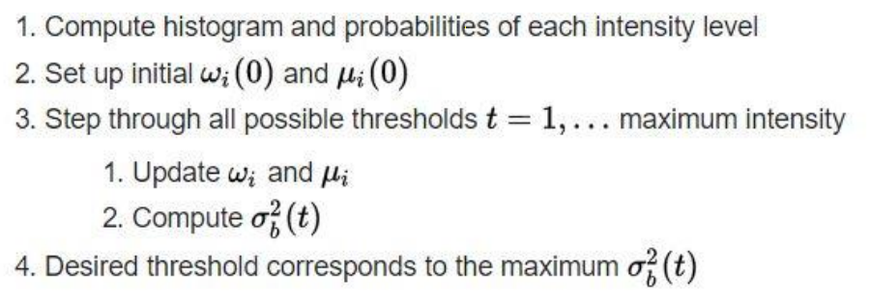
Otsu Serial Implementation

Slide 4
Parallel implementation of Otsu in Python using pymp
#/* binarization output into image2 */
x_size2 = x_size1
y_size2 = y_size1
with pymp.Parallel(2) as p1:
with pymp.Parallel(2) as p2:
for y in p1.range(0,y_size2):
for x in p2.range(0,x_size2):
if (image1[y][x] > threshold):
image2[y][x] = MAX_BRIGHTNESS
else:
image2[y][x] = 0

Slide 5
Code Runtime
Image Size | 747*749 |  | 3000*4000
 | Time | Speed up | Time | Speed up
Serial Code | 04.349644 | - | 01:32.969159 | -
Parallel (2 cores) | 03.565550 | 1.219 | 01:17.713817 | 1.196
Parallel (4 cores) | 03.711449 | 1.172 | 01:17.542181 | 1.199
Parallel (6 cores) | 03.812567 | 1.141 | 01:17.224416 | 1.204

Slide 6
Parallelising K-Means clustering for Color-based Image Segmentation
Given an image and an integer number K, The k-means clustering algorithm can be used to partition the image pixels into K groups, in such a way that pixels in the same group are similar in terms of color
Cluster initialisation
Pixel Assignment
Update center
yes
Update image
Check for changes
no

Slide 7
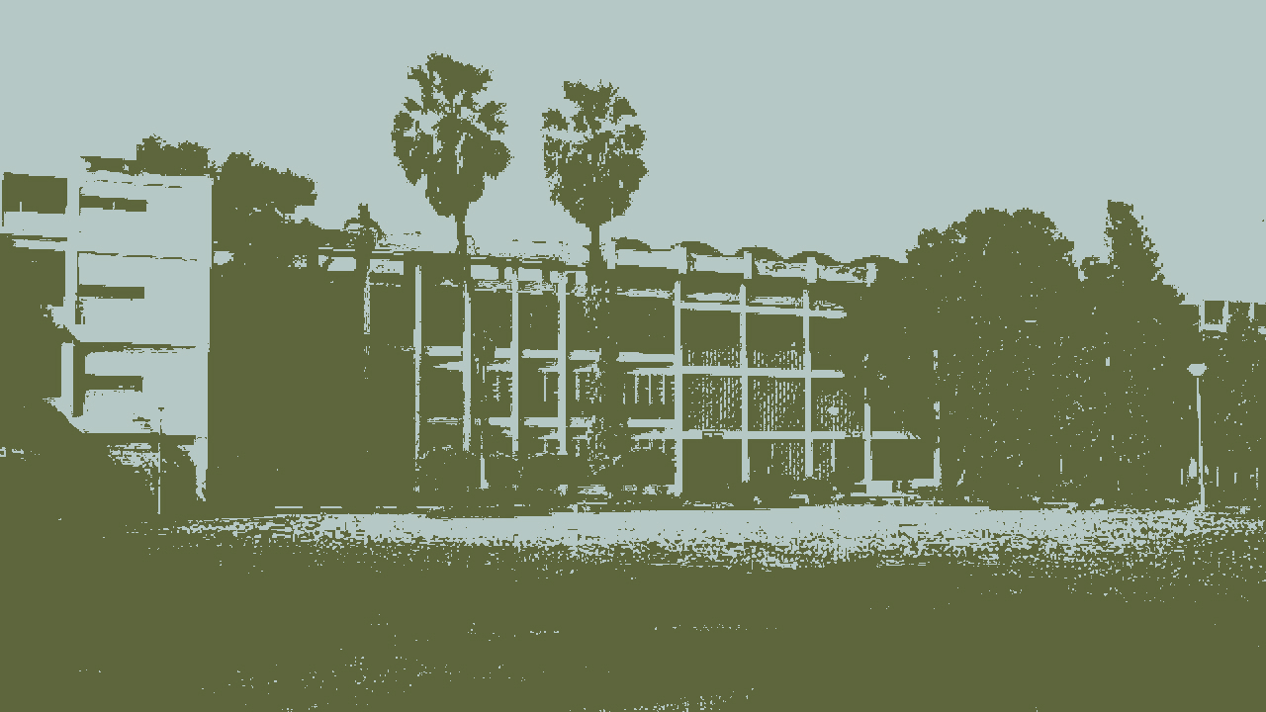
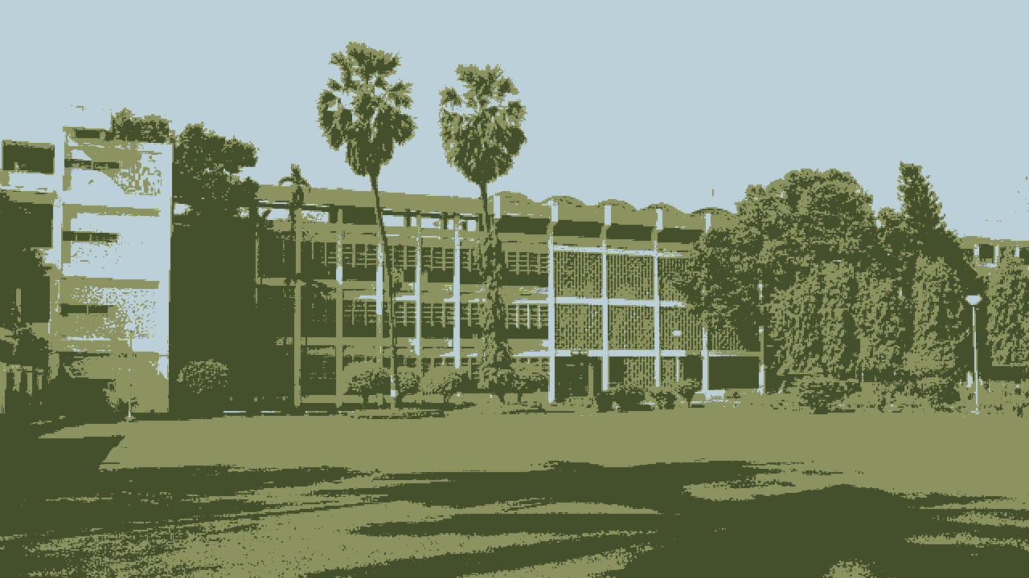
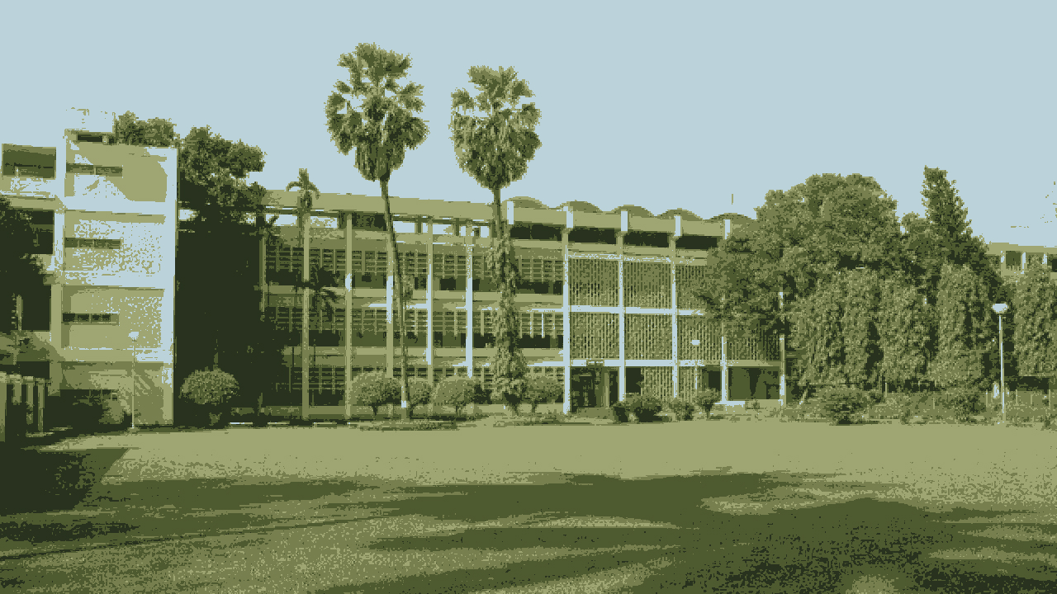
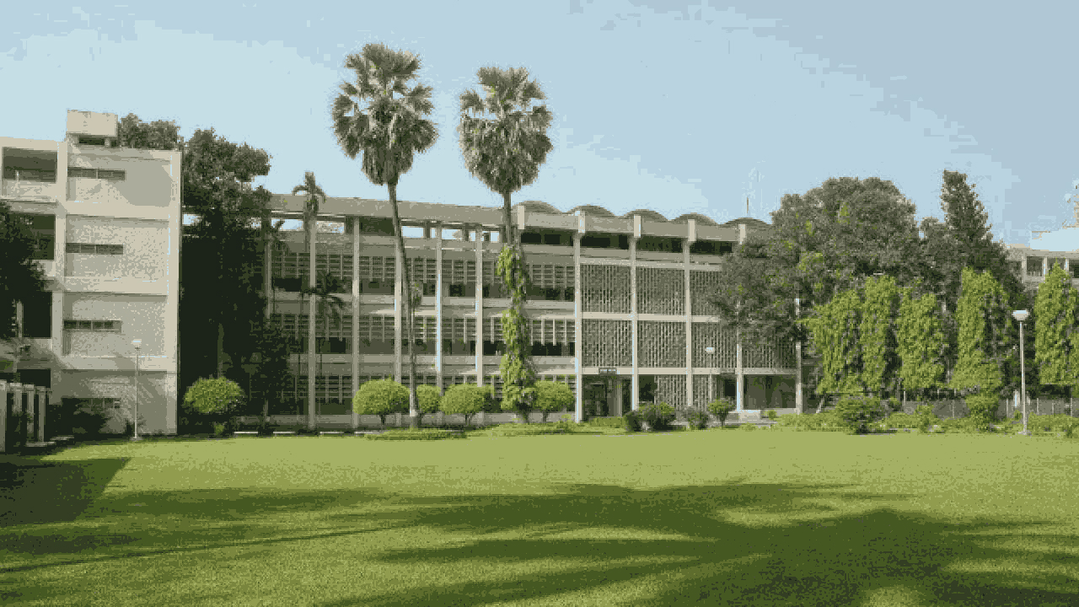
K = 2
K = 3
K = 5
K = 16

Slide 8
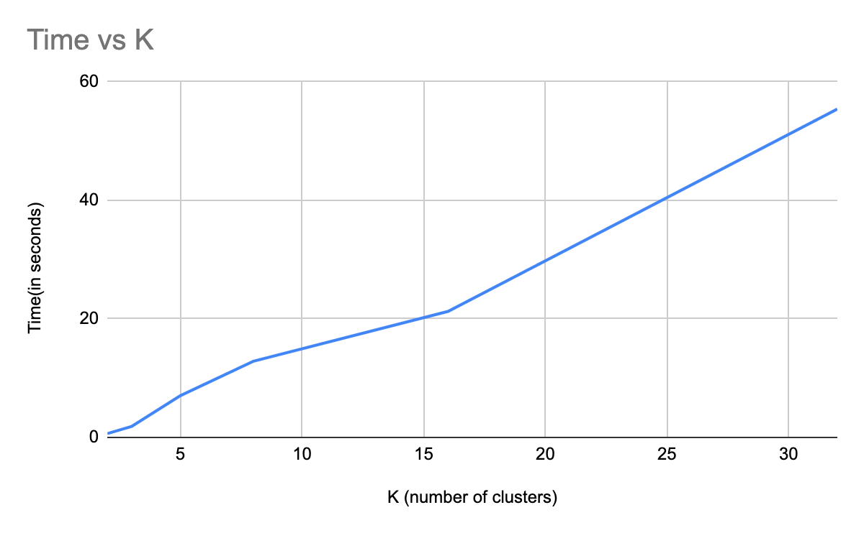
Sequential code runtime
K (number of clusters) | Time(in seconds)
2 | 0.642773
3 | 1.857564
5 | 7.035693
8 | 12.844987
16 | 21.2569
32 | 55.388927

Slide 9
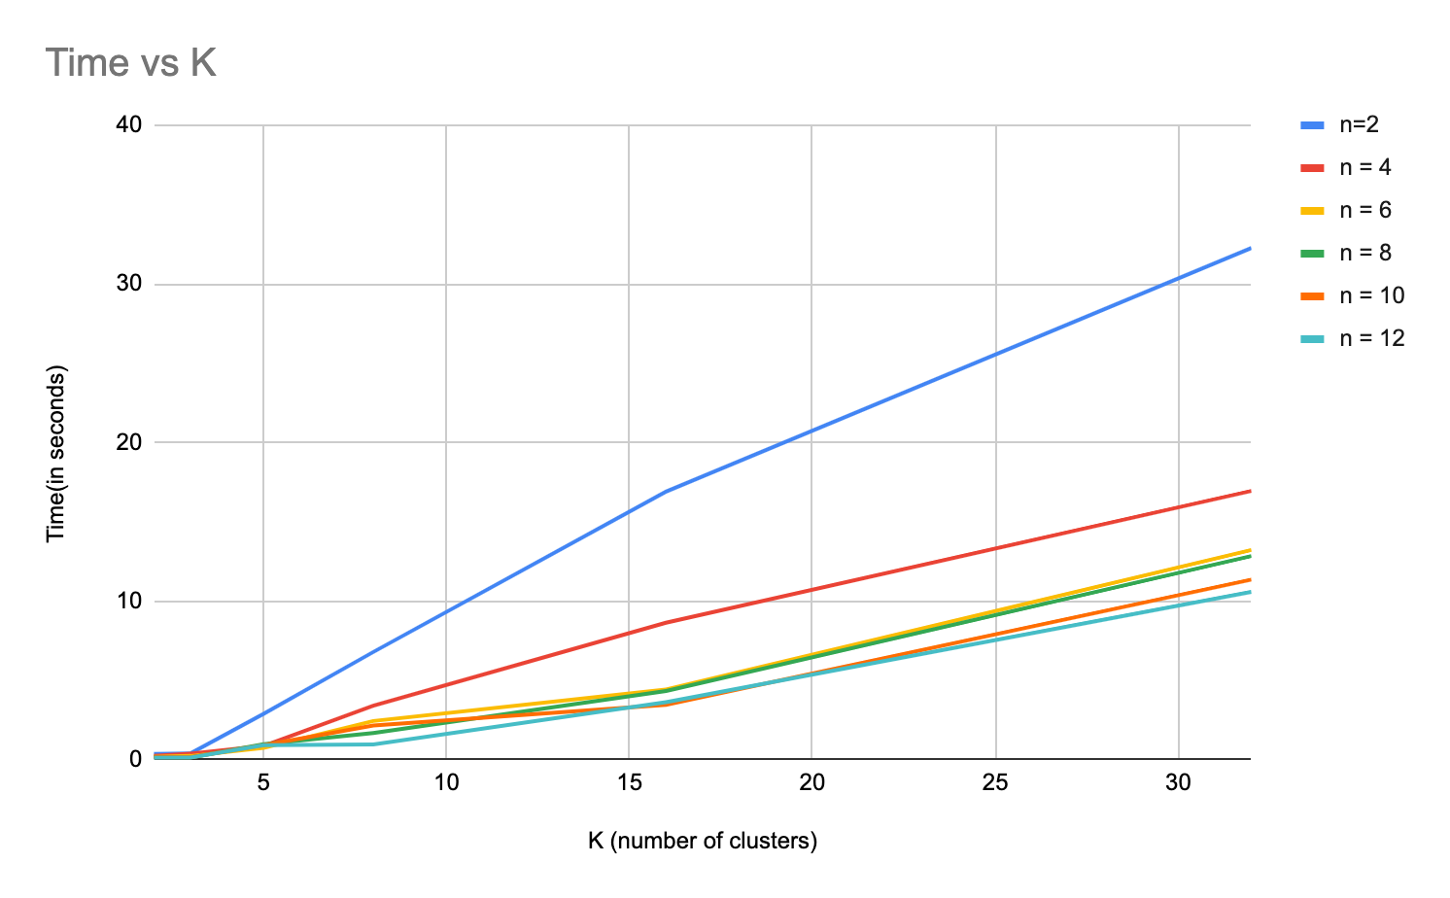
Parallel code runtime
K (number of clusters) | Time(in seconds) n - number of threads
 | n=2 | n = 4 | n = 6 | n = 8 | n = 10 | n = 12
2 | 0.372275 | 0.254146 | 0.188513 | 0.172551 | 0.154262 | 0.125635
3 | 0.400883 | 0.379079 | 0.240873 | 0.142251 | 0.15388 | 0.13442
5 | 2.89449 | 0.875069 | 0.745475 | 0.978225 | 0.927522 | 0.91979
8 | 6.797256 | 3.408044 | 2.44726 | 1.687233 | 2.168198 | 0.960925
16 | 16.91064 | 8.642086 | 4.425368 | 4.331817 | 3.463592 | 3.634403
32 | 32.27271 | 16.950818 | 13.233873 | 12.845837 | 11.363671 | 10.59308

Slide 10
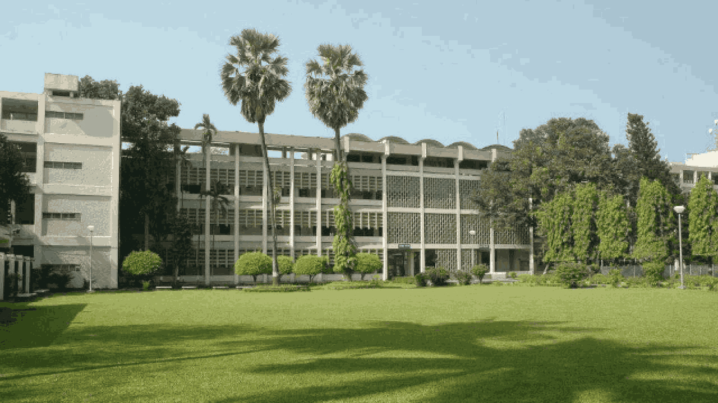
K = 32
K (number of clusters) | Speedup n - number of threads
 | n=2 | n = 4 | n = 6 | n = 8 | n = 10 | n = 12
2 | 1.726608018 | 2.5291486 | 3.409701188 | 3.72511895 | 4.166761743 | 5.116193736
3 | 4.633681149 | 4.90020286 | 7.711798334 | 13.0583546 | 12.07151027 | 13.8191043
5 | 2.430719401 | 8.040157976 | 9.43786579 | 7.192305451 | 7.585472905 | 7.649238413
8 | 1.889731239 | 3.769020294 | 5.248721836 | 7.613048702 | 5.924268448 | 13.36731483
16 | 1.257013336 | 2.459695495 | 4.803419738 | 4.907155589 | 6.137241338 | 5.848801027
32 | 1.71627753 | 3.26762561 | 4.18539055 | 4.31181923 | 4.874210719 | 5.22878398
Machine specifications:
(for k-means analysis)
Machine: MacBook Pro (15-inch, 2019)
Processor: 2.6 GHz 6-Core Intel Core i7
Memory: 16 GB 2400 MHz DDR4
Due to intel hyperthreading,
12(6*2) cores are available

